Slide 1
Sales Data Analysis: Data Storytelling and Statistical validation
Task 4 – Data Analytics Internship
Presented by : Devangam Narayanaswamy Veena
College : Sri Venkateshwara College of Engineering, Tirupati
Branch : Information Technology
Date : July 2026

Slide 2
Project Objective
Perform data cleaning and exploratory data analysis (EDA) to improve data quality.
Use SQL to answer business questions through filtering, aggregation, and data analysis.
Develop interactive dashboards in Power BI to visualize key performance indicators (KPIs).
Present findings through data storytelling and statistical validation to support business decision-making.
Analyze the sales dataset to identify trends, patterns, and business insights.

Slide 3
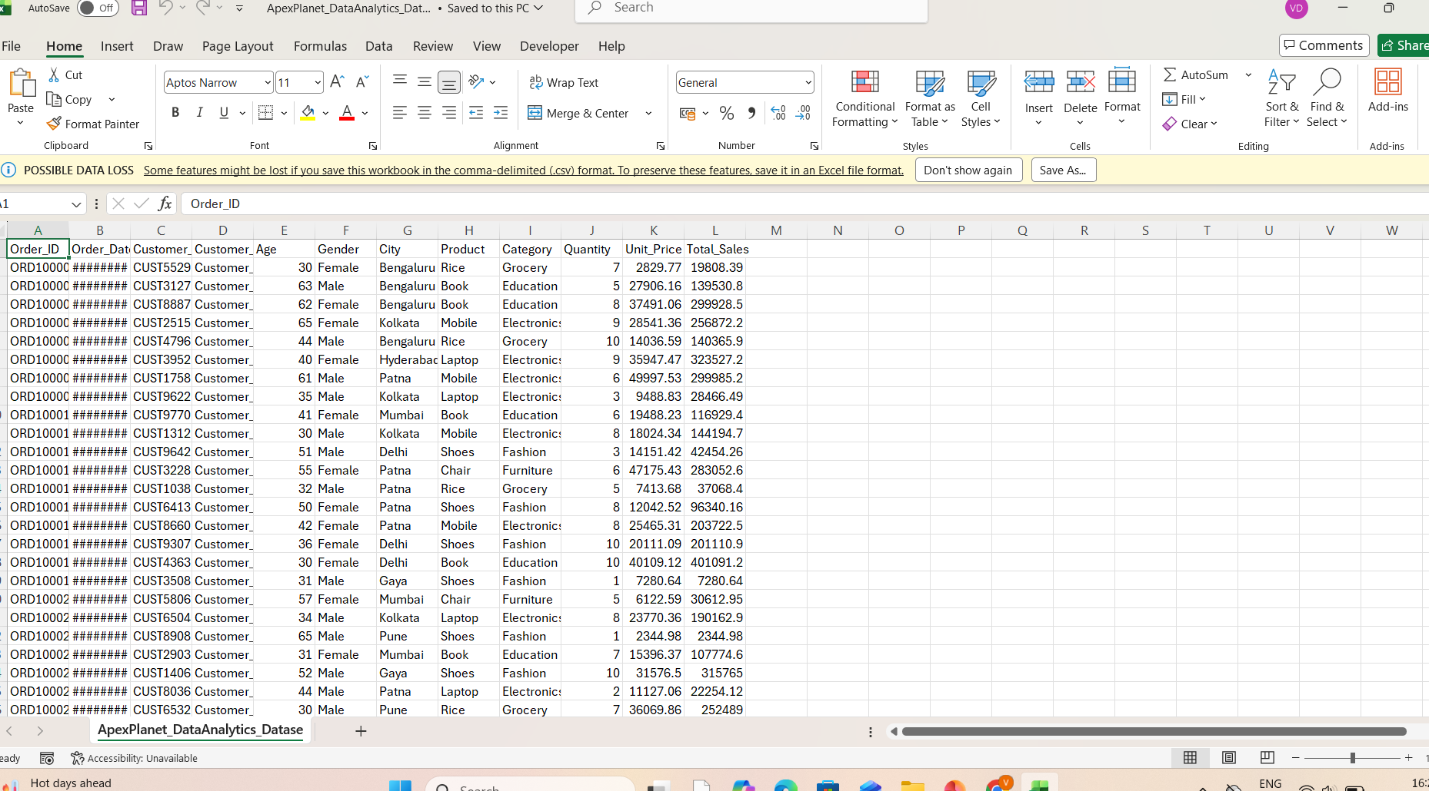
Dataset Overview
Dataset Name
Sales Dataset
Description
Retail sales transaction data
Customer, product & sales details
Used for sales performance analysis
Dataset Summary
Records: 1000
Columns: 11
Key Columns
Order_ID
Customer_ID
Product
Category
City
Total_Sales

Slide 4
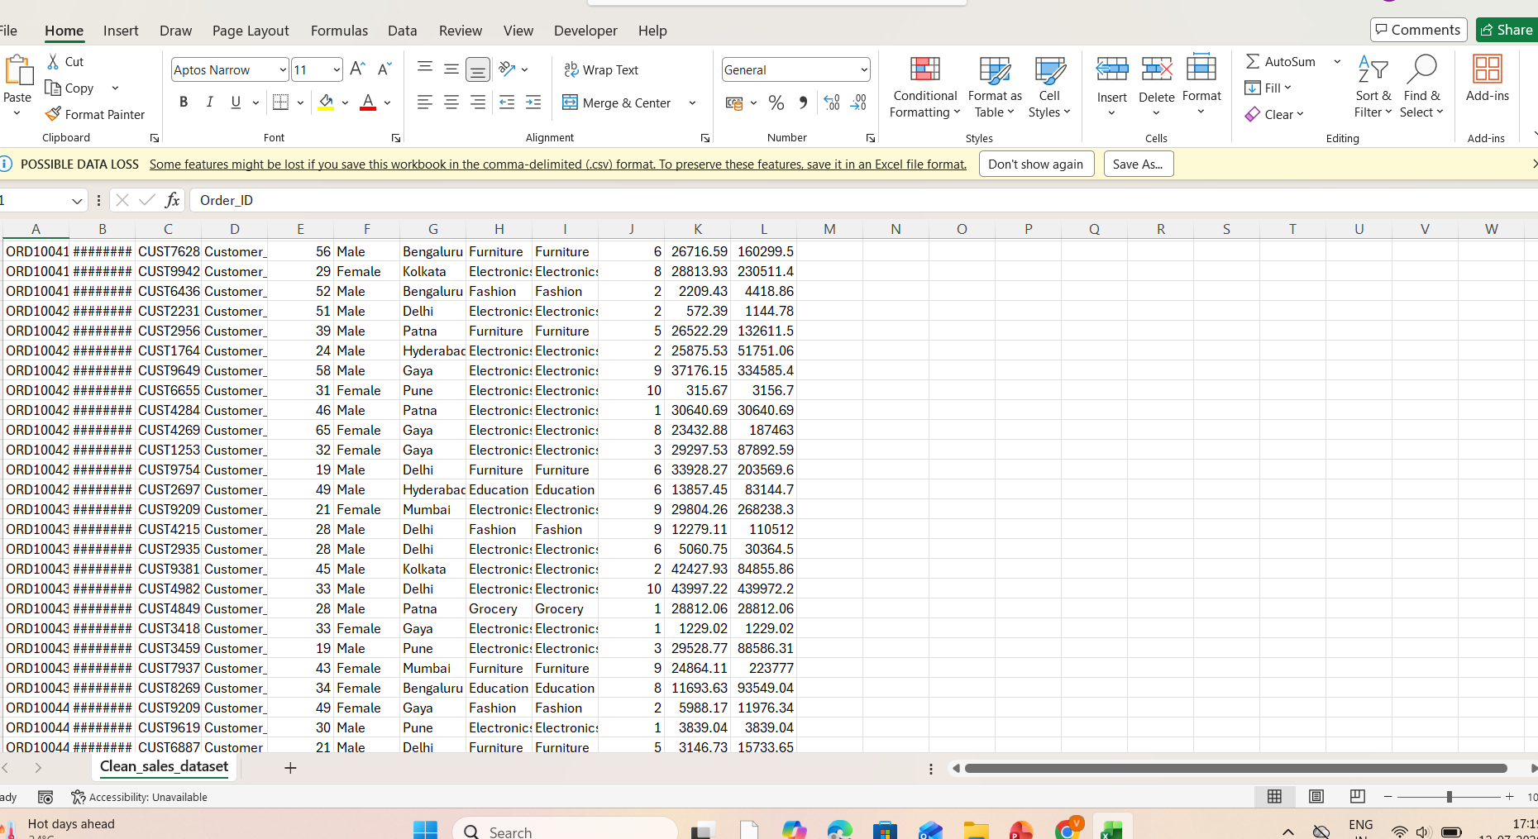
Data Cleaning Process
Imported the sales dataset into MySQL.
Checked for missing values and handled them.
Removed duplicate records.
Verified and corrected data types.
Cleaned inconsistent values and standardized the dataset.
Validated the cleaned data for accurate analysis.

Slide 5
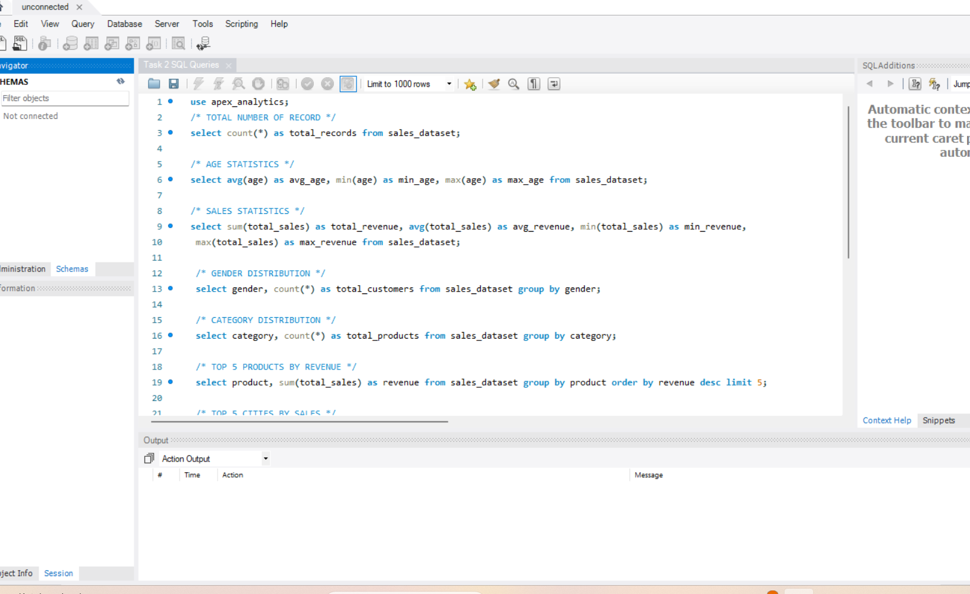
Exploratory Data Analysis(EDA) and SQL Analysis
Business Questions Answered
Top 5 cities by total revenue.
Best-selling product categories.
Monthly sales trend analysis.
Total revenue generated by each product.
Customer distribution by gender.
Category-wise sales performan.
Key Findings
Revenue varied significantly across cities.
Electronics generated the highest sales.
Monthly sales showed an overall increasing trend.
Customer purchases were almost equally distributed by gender.

Slide 6
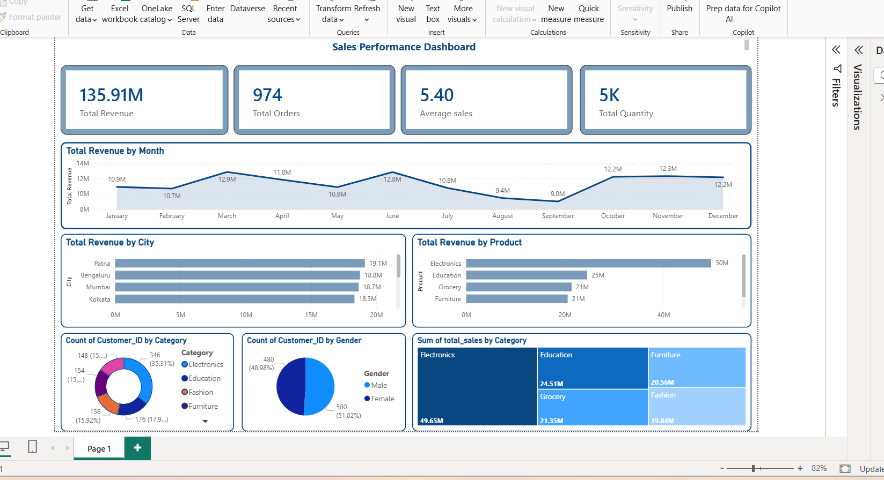
Power BI Dashboard
Dashboard Highlights
Interactive dashboard developed using Power BI.
KPI cards display Total Revenue, Total Orders, Average Sales, and Total Quantity.
Visualizations show monthly sales trends, city-wise revenue, and product performance.
Category-wise and gender-wise analysis helps understand customer purchasing patterns.
Dashboard enables quick and data-driven business decision-making.

Slide 7
Key Business Insights
Key Insights
Total revenue indicates strong overall sales performance across the dataset.
A few cities contributed the highest share of total revenue.
Electronics was the top-performing product category.
Monthly sales analysis revealed clear trends in customer demand.
KPI analysis helped monitor revenue, orders, average sales, and quantity sold.
The dashboard provided valuable insights for business decision-making.

Slide 8
Business Recommendations
Focus marketing efforts on top-performing cities to maximize revenue.
Increase inventory for high-demand products and categories.
Develop promotional strategies for low-performing products.
Monitor monthly sales trends to improve sales planning and forecasting.
Use the Power BI dashboard regularly to support data-driven business decisions.

Slide 9
Hypothesis Testing and Statistical Validation
Business Hypothesis
H₀ (Null Hypothesis): There is no significant difference in average sales between product categories.
H₁ (Alternative Hypothesis): There is a significant difference in average sales between product categories.
Statistical Test Used:
Independent Sample T-Test
Conclusion:
The statistical test was used to evaluate the hypothesis and determine whether the observed difference in average sales was statistically significant.
The results help support data-driven business decisions.

Slide 10
Conclusion
Project Summary
Successfully completed data cleaning, exploratory data analysis, SQL analysis, and Power BI dashboard development.
Identified key business insights from the sales dataset through data analysis and visualization.
Applied data storytelling and basic statistical validation to support business decision-making.
Enhanced practical skills in SQL, Power BI, data analysis, and business intelligence.
This project demonstrates the value of data-driven decision-making in solving real-world business problems.
Thank You!

